Slide 1

Cyber Incident Command System
https://github.com/Hnikar-az/bshq
A People Orchestration Layer
Notes:
Scott

Slide 2


Blake, Scott
Notes:
Scott:
Experience,
Blake:
Experience and flow to next slide

Slide 3
Disclaimer
This presentation not represent the positions, policies, or procedures of the United States Government, the places we work, or volunteer for.
Notes:
Blake

Slide 4
Agenda
The Problem (A State Of Confusion)
Introduce the solution
Example of the solution at work - A quick hospital story
The Systems
Would you like to know more?
Notes:
Blake
Problem
Stories
Existing Solution

Slide 5

The Problem
We’re stuck with the people we have during an incident.
Meaningful resource sharing does not exist.
Existing systems are dangerous to responders
Photo by Igor Omilaev on Unsplash
Notes:
Scott: I’m doing my part
Every time one of us changes companies, signs onto a new contract, is assigned a new customer, we need to learn their way of working or they need to learn our way of working
Staff safety - Mutual aid is very difficult
There must be a better way!
There is no cross talk between organizations and how they built their incident response systems:
Time must be dedicated to administrative overhead - individual staff member and their team members technical staff
We’re stuck with the people we have during an incident.
Incident responders do not have the flexibility to move between agencies or organizations without administrative process training.
There’s no standard for organizing people.There is no mutual aid.
Resources are finite and limited to individual responding organizations

Slide 6

Photo by Anders Norrback Bornholm on Unsplash
Notes:
Blake:
There is a better way, This discussion will focus on strategic and operations rather than tactical response plans like Incident Response and Vulnerability Management. The reason we do this is to address the staff safety problem and constant relearning of new processes with different organizations.
We are describing a system that organizes people to respond to disasters
It’s used by all incident responders (except IT) in the United States
Scott: Hey it sounds like you’re just creating a new standard. Isn’t there an XKCD comic about creating yet another standard?

Slide 7

https://xkcd.com/927/ No changes made, https://creativecommons.org/licenses/by-nc/2.5/
Notes:
Blake: No! This is the standard already in use in every industry in the United States and beyond.
Yes, but this isn’t applicable here. NIMS is a standard which everyone else ALREADY uses.
No, this is the standard, we need to stop making others
This is an existing standard used everywhere
We’re not building a new standard
We’re simplifying the existing one for IT and Cybersecurity play well with others

Slide 8
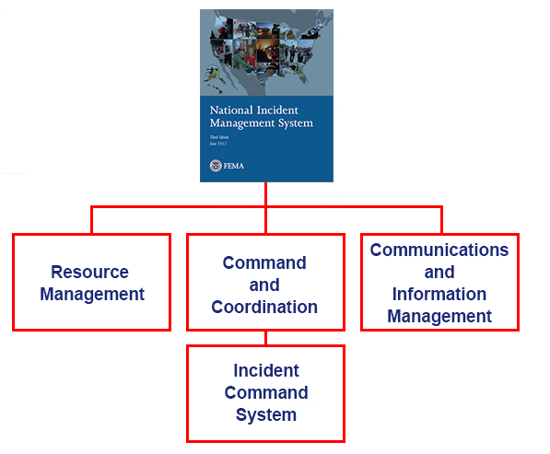
National Incident Management System
A people orchestration layer
Results in & Contains Information About:
Staff Safety
Transferable Operations
https://training.fema.gov/is/coursematerials.aspx?code=IS-100.c IS-100.C: Introduction to the Incident Command System, ICS 100
Notes:
Blake
What is it? Who uses this?
A firefighter, police officer, nurse or doctor from New York City can travel to any other department in the entire country and use the same language, organizational structures, methods and means.
IT needs to be able to make the same move
Standardization
Flexibility
Unity of Effort
Resource Management
Command & Coordination
Incident Command System
Communications & Information Management

Slide 9
Where are we in the system
Manageable Span of Control
Modular Organization
Chain of Command and Unity of Command
Common Terminology
Management by Objective
Comprehensive Resource Management
Establishment and Transfer of Command
Dispatch/Deployment
Incident Action Planning
Incident Facilities and Locations
Integrated Communications
Unified Command
Accountability
Information and Intelligence Management
Notes:
Blake
This slide is th e14 characteristics of nims
“You are here”
We’re only covering a limited set of information, there’s a deep system here but we’re only discussing three elements today:
Manageable Span of Control
Chain of Command and Unity of Command
Modular Organization

Slide 10


Cyber Incident Command System - CICS
A People Orchestration Layer
Photo by Milad Fakurian on Unsplash
Photo by Job Savelsberg on Unsplash
A lighter version of the National Incident Management System
Simplified Command and Control Structure
New Role:
Mental Health Officer Replaces or Augments Safety officer
Notes:
Scott: I want to do my part!
Blake, describe CICS at a high level with an emphasis on Mental Health & Safety Officer

Slide 11
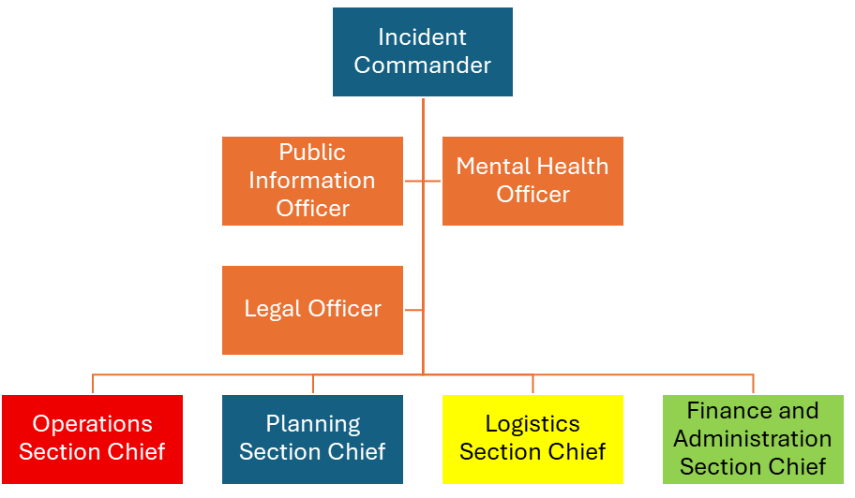
Modular Organization
Notes:
Blake:
Role based structure, like function calls
Command and Coordination describes leadership roles, processes, and recommended organizational structures for incident management at the operational and incident support levels and explains how these structures interact to manage incidents effectively and efficiently.
Division of work into organizational structures of the Operations, Planning, Logistics, and Finance and Administration Sections
Flexibility of the system to grow organically with incident complexity and scale
Modular Organizational structure
Manageable Span of Control

Slide 12

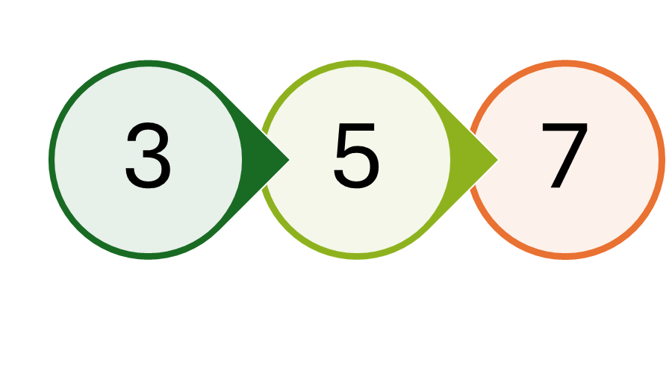
Manageable Span of Control
Photo by Gustavo Sánchez on Unsplash
Notes:
Blake
Span of control defining the best supervisor worker:ratio
1 supervisor : 5 workers
Span of Control
Demonstrate with fire trucks up to a type 1 team - High Level - Blake
Span of control - High Level - Scott - Tested and proven in dangerous situations

Slide 13
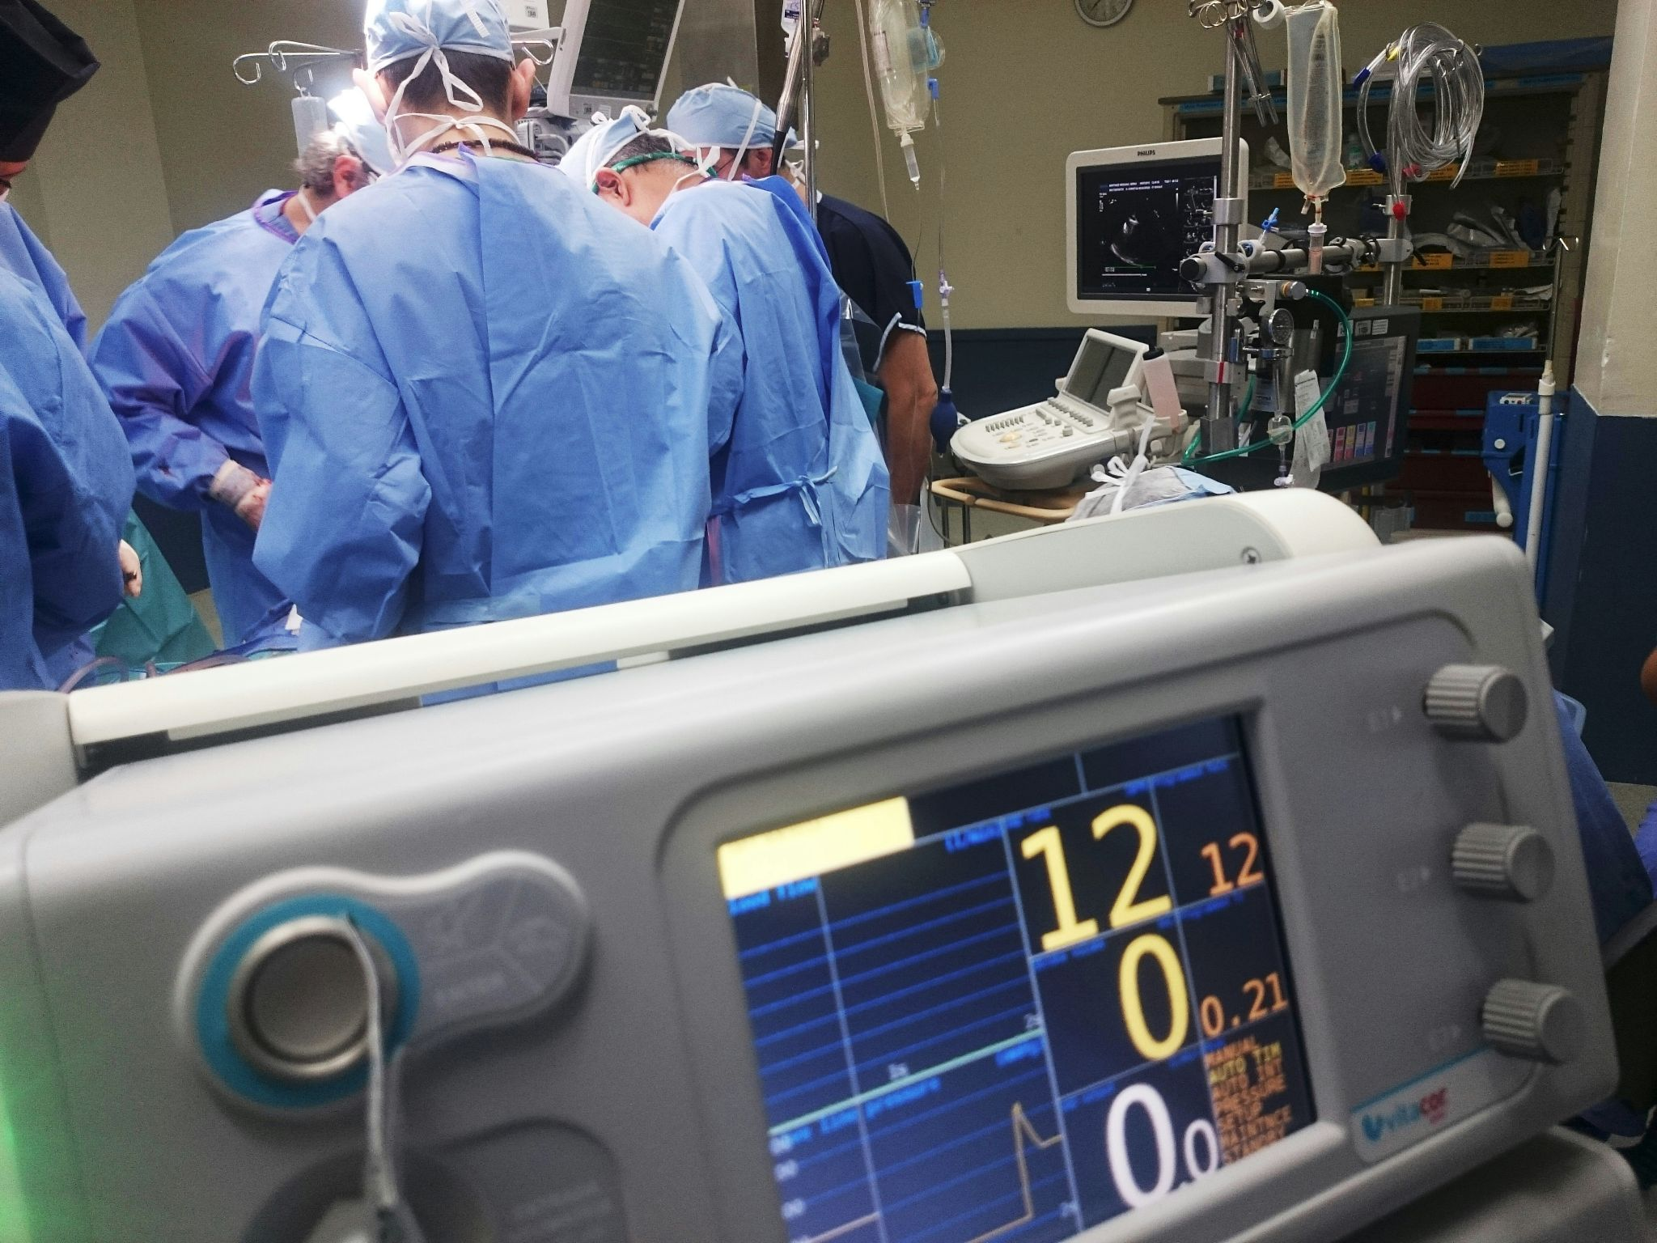
Story Time - A problem occurs
So you see what had happen’d was
Photo by Natanael Melchor on Unsplash
Notes:
Scott: Let’s show you an example of CICS in action
It’s a normal day at the hospital
People are showing up and receiving care
Vampires are drawing blood
Surgeries are taking place
Insurance is overbilling folks for medically necessary care
All seems well
IT Helpdesk receives calls for computers not working and some systems are displaying a message. The issue is not clear and there may be an internet outage or it could be ransomware.
The IT support team notices a significant increase in helpdesk tickets for non-operational computers
IT Helpdesk Manager declares a Disaster and becomes Incident Commander

Slide 14
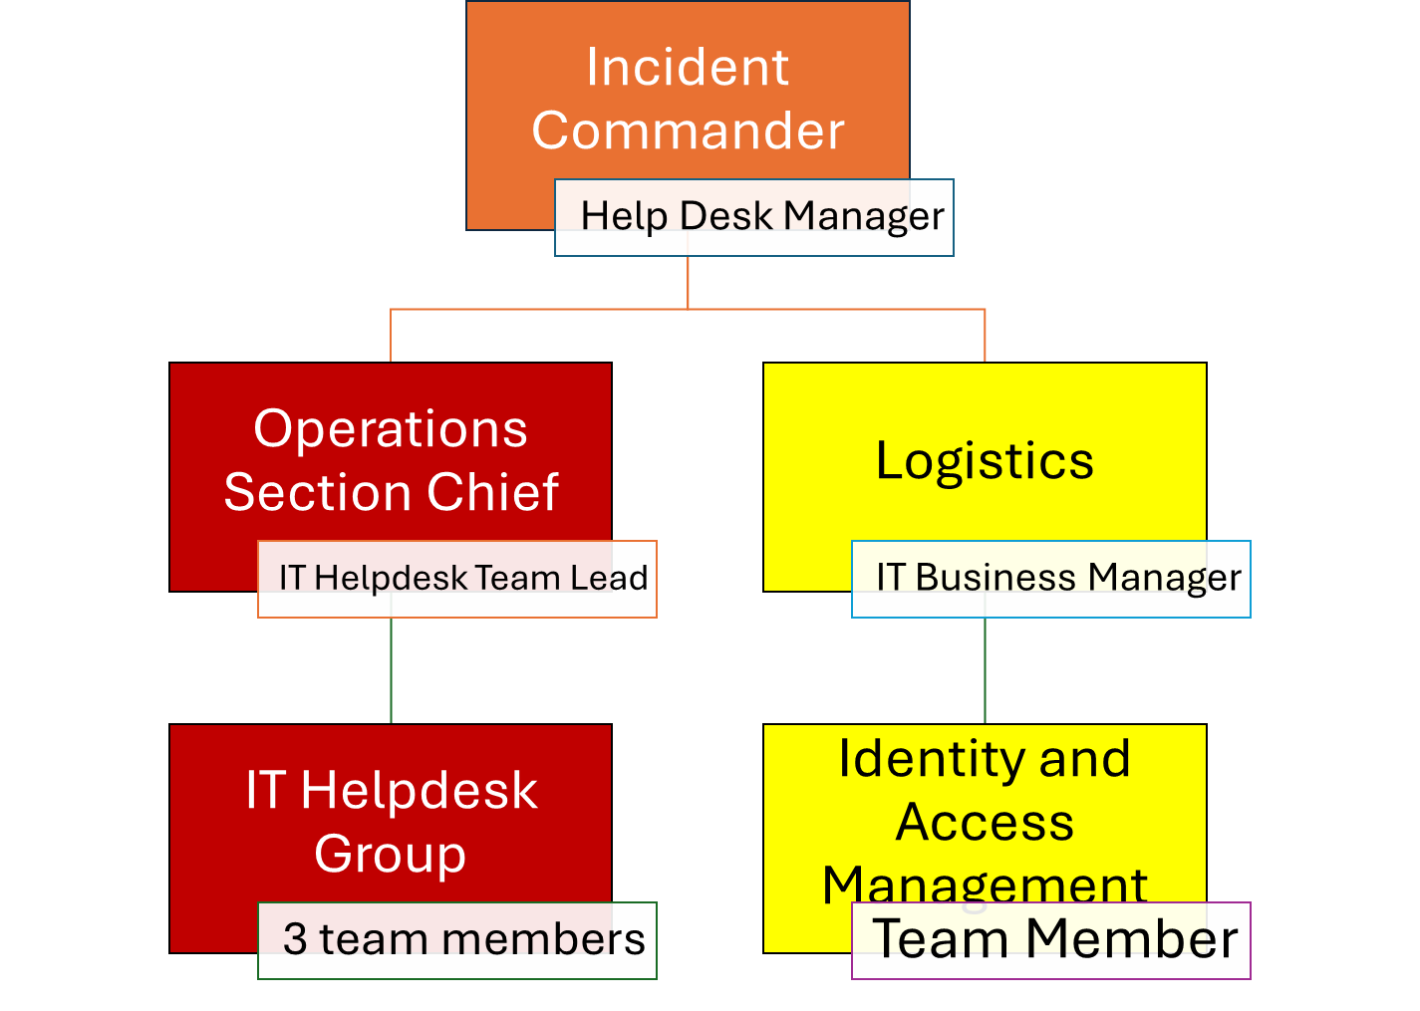
The Incident Begins
A Type 5 Response Team
Notes:
Scott:
This is the smallest response team, a TYPE 5 response team. Type 1 is the largest team, here is a TYPE 5 team. At this early stage of the incident, responders are limited to the resources on hand, in this case, the Helpdesk team.
All day to day operations cease for the people involved so they can focus on the issue.
Incident Command assumes all roles not specifically assigned
Operations Section Chief manages the responding team members only
IT Helpdesk Group is the individual contributors doing the work to respond to ticket & issues. They are the firefighters on the ground
IAM provides support to ensure Operations has the permissions they need to accomplish their work
Incident Commander: The individual responsible for on-scene incident activities, including developing incident objectives and ordering and releasing resources. The Incident Commander has overall authority and responsibility for conducting incident operations.
Operations Section: The ICS Section responsible for implementing tactical incident operations described in the IAP. In ICS, the Operations Section may include subordinate branches, divisions, and/or groups.
Blake:
Logistics section
Logistics has the power of resource acquisition. This could be simple as lunch for the team or calling outside workers inside the org or from outside the organization in distress. Logistics is not responding to the incident directly. -
Logistics Section: The ICS Section responsible for providing facilities, services, and material support for the incident.

Slide 15
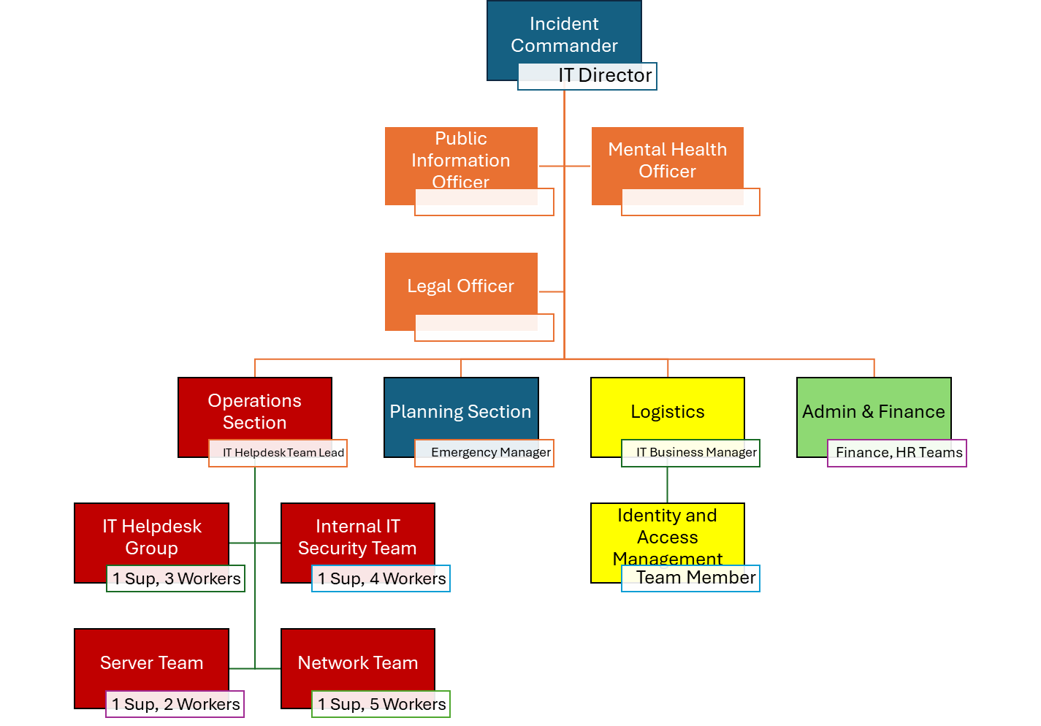
The Incident Expands Beyond Helpdesk Control
Notes:
Scott:
The incident expands
New IC - IT Director
Mental Health Officer - Trusted team member to check in with staff during the incident. This position has “Full Stop” authority without repercussions from management or leadership
Monitors team members for burnout and rest requirements
Operations Sections:
IT Teams in play under operations:
Desktop Support
Server
Network
VoIP
Note that IT Helpdesk is still involved but have moved down stack.
Blake:
Planning Section Chief - Emergency Manager who is already on staff
Planning Section: The ICS Section that collects, evaluates, and disseminates operational information related to the incident and for the preparation and documentation of the IAP to internal teams. This section also maintains information on the current and forecasted situation and on the status of resources assigned to the incident.
Logistics - Buying team & IT Business Manager
Public Information Officer - Marketing & PR teams that exist within the hospital
Finance & Admin - Finance Department & HR Finance/Administration Section: The ICS Section responsible for an incident’s administrative and financial considerations.
WHO IS MISSING FROM THIS ORG CHART?

Slide 16

Who is missing from that organizational chart?
Photo by Tanja Tepavac on Unsplash
Notes:
Blake

Slide 17
Who’s missing?
https://github.com/Hnikar-az/bshq
Notes:
Blake: Ask the audience!
HINT: It’s a hospital

Slide 18
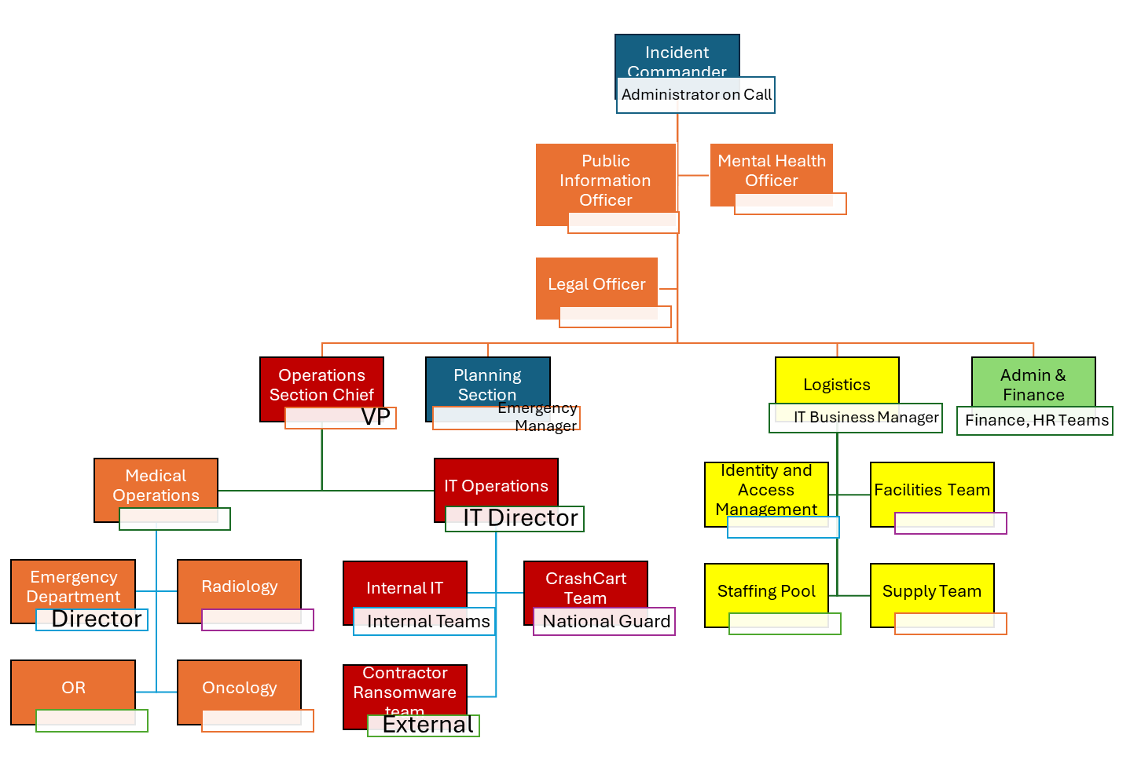
The Incident Expands Again
https://github.com/Hnikar-az/bshq
Notes:
Scott:
New IC - Admin on call
Mental Health Officer - Trusted team member to check in with all staff during the incident. This position has “Full Stop” authority without repercussions from management
Monitors team members for burnout and rest requirements.
Operations Sections:
IT Teams continue to do their good work
Medical teams move to their downtime procedures and conduct internal operations
Planning Section Chief - Emergency Manager who is already on staff
Logistics - Buying team & IT Business Manager
Finance & Admin - Finance Department & HR

Slide 19
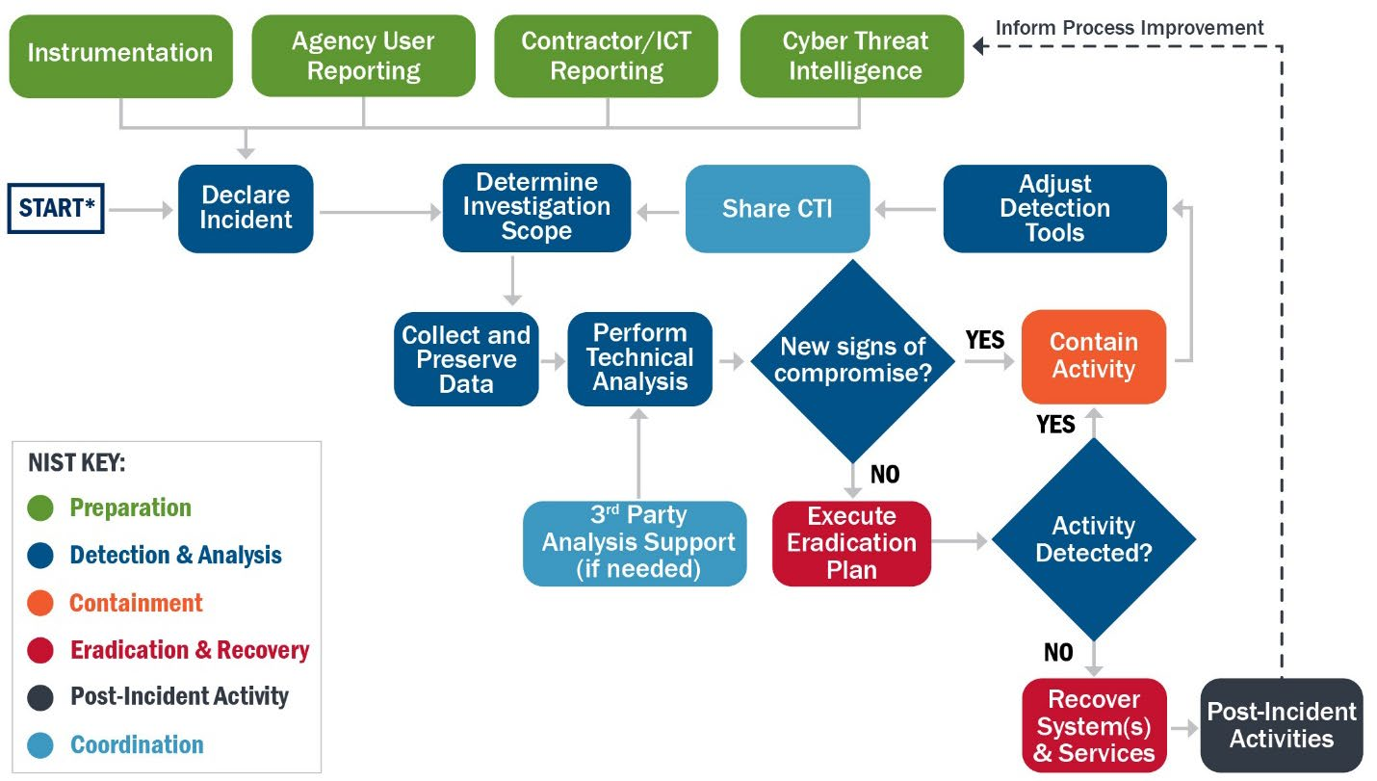
CISA Incident & Vulnerability Response Playbook
https://www.cisa.gov/sites/default/files/2024-08/Federal_Government_Cybersecurity_Incident_and_Vulnerability_Response_Playbooks_508C.pdf
Notes:
Scott: Your scrum, Agile, Waterfall, ITIL, NIST Incident Response and others will fit inside of this system. The incident command system does not prescribe tactics. Incident Command manages operations and strategy. Let us show you why.

Slide 20
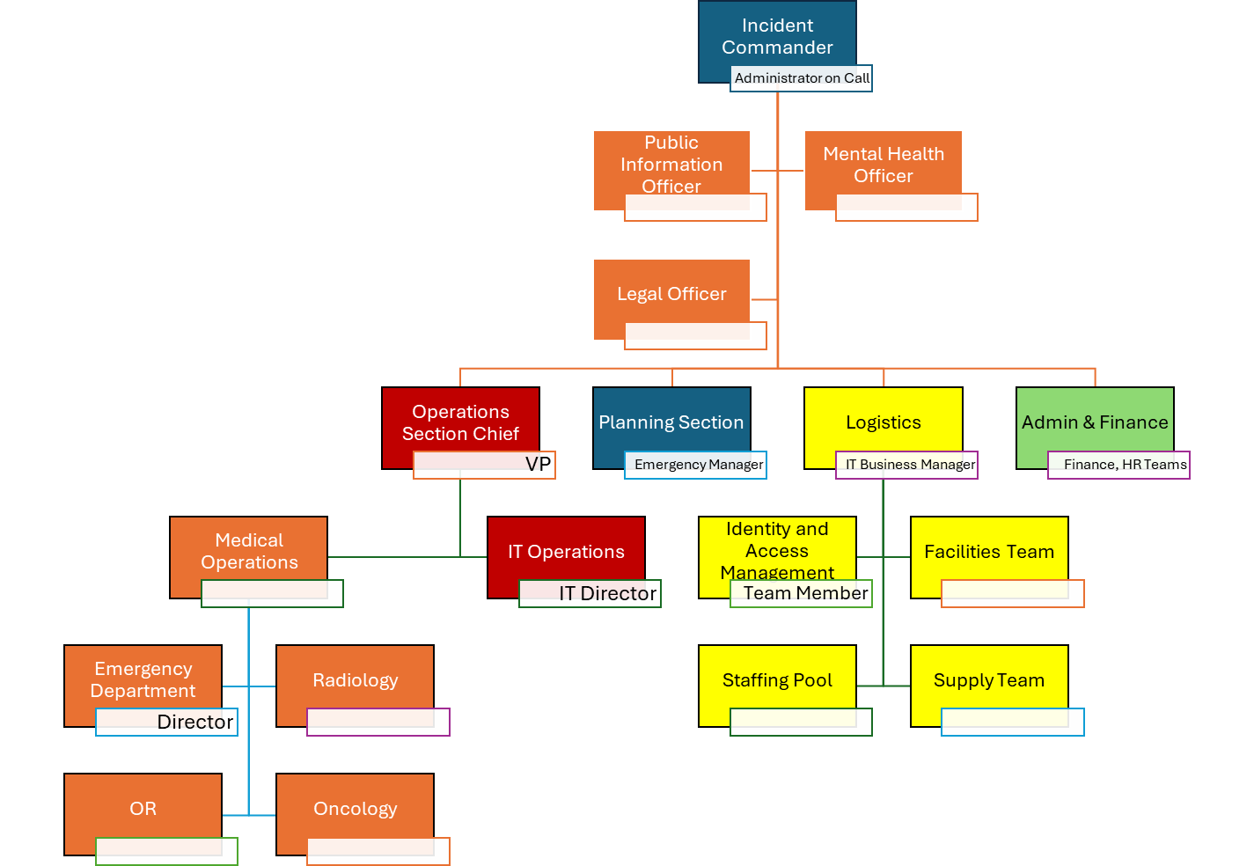
But My Incident Command System Is The Bestestest
Notes:
Scott: You are here.
All of the incident response playbooks and tactics fit inside of IT Operations. Other responding parties and organizations can work with IT to deal with the incident.

Slide 21

Photo by Markus Winkler on Unsplash
Notes:
Blake: Let’s review
This is not a new standard, this is a simplified step to the National Incident Management System.
Your standard sucks and Disaster Responders outside of IT are making fun of IT behind our backs
Everyone else uses this standard, you are the weird one
If you want to work in Critical Infrastructure, hospitals, or work with local governments you need to use this to engage well
We think you can build modular organizations right now at your org and be effective

Slide 22
Modular Organization
Notes:
Blake
Role based structure, like function calls
Public Information Officer, who interfaces with the public and media and/or with other agencies with incident-related information requirements.
Liaison Officer, who serves as the Incident Commander’s point of contact for representatives of governmental agencies, non-governmental organizations (NGOs), and private-sector organizations.
Incident Command: Sets the incident objectives, strategies, and priorities, and has overall responsibility for the incident.
Operations: Conducts operations to reach the incident objectives. Establishes tactics and directs all operational resources.
Planning: Supports the incident action planning process by tracking resources, collecting/analyzing information, and maintaining documentation.
Logistics: Arranges for resources and needed services to support achievement of the incident objectives (resources can include personnel, equipment, teams, supplies, and facilities).
Finance/Administration: Monitors costs related to the incident. Provides accounting, procurement, time recording, and cost analyses.
Command and Coordination describes leadership roles, processes, and recommended organizational structures for incident management at the operational and incident support levels and explains how these structures interact to manage incidents effectively and efficiently.
Division of work into organizational structures of the Operations, Planning, Logistics, and Finance and Administration Sections
Flexibility of the system to grow organically with incident complexity and scale
Modular Organizational structure
Manageable Span of Control

Slide 23
Manageable Span of Control
Photo by Gustavo Sánchez on Unsplash
Notes:
Blake
Span of control defining the best supervisor worker:ratio
1 supervisor : 5 workers
Span of Control
Demonstrate with fire trucks up to a type 1 team - High Level - Blake
Span of control - High Level - Scott - Tested and proven in dangerous situations

Slide 24
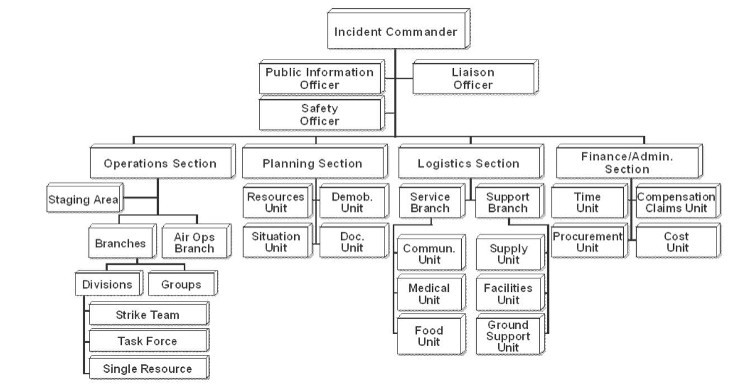
https://training.fema.gov/emiweb/is/icsresource/assets/ics%20organizational%20structure%20and%20elements.pdf
Notes:
BLAKE
It gets more roles as things become more work intensive

Slide 25
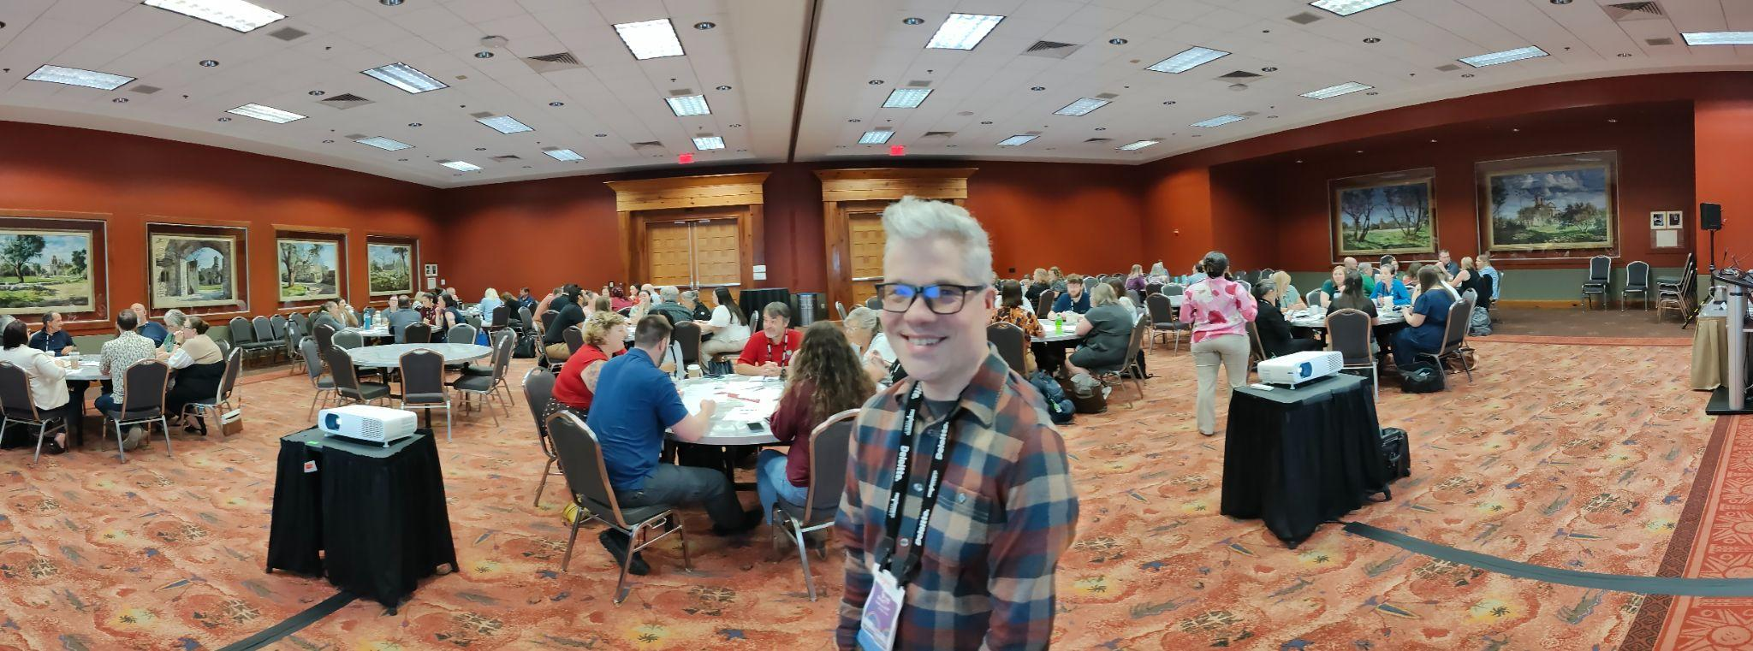
Preparedness Summit 2025 - National Association of City and County Health Officials (NACCHO)
Notes:
Scott
Complex coordinated disaster; an extreme heat and cyber security attack
All 77 participants agreed immediately on the approach to the problem; National Incident Management System (NIMS)
Unanimous decision by silent agreement
Interoperability between responding agencies allowed responding parties to focus on the event without debating the best way to begin discussing the incident
All of our hospitals, cities, counties, public works, Department of Transport, fire departments and police departments use NIMS

Slide 26

The Highlights of Cyber Incident Command System
Photo by Philipp Katzenberger on Unsplash
Simplified language for faster adoption of the National Incident Management System
Mental Health officer
Legal Officer
Span of Control guidance
Notes:
Scott:
We want to highlight these benefits for the CICS system

Slide 27

The Problem
Photo by Daria Glakteeva on Unsplash
We’re stuck with the people we have during an incident.
Meaningful resource sharing does not exist.
Existing systems are dangerous to responders
Notes:
SCOTT
Incident Responders do not have the flexibility to move between agencies or organizations without administrative process training
Typed & Kind’d IT Positions
Existing systems do not prioritize staff safety
Mental Health Professional
Staff rotation for multiple operational periods
Legal can play too, I guess

Slide 28
FEMA Independent Study Courses
ICS 100 - Introduction to Incident Command System
ICS 700 - National Incident Management System (NIMS), An Introduction
Notes:
Blake
Blake took 40 hours of courses
40 hours of classes to do one role
This system is extraordinarily deep
There’s a shit load of information here
You can take training, but you don’t need to
Take command and lead people
Define roles and responsibilities and approach emergencies collectively with other organizations (governments and public sector)

Slide 29
Help Build CICS
We need your experience
We want your expertise
Be the Calvary

Slide 30
JOIN UP NOW
https://github.com/Hnikar-az/bshq
Blake Scott: blake@hnikar.com
Scott Fraser: scott@codelinenetworks.com
Thank you to the unsplash community for providing us free copyleft images made by human hands. XKCD provided a comic, US government provided some images.
No AI was harmed in the creation of this presentation, all photos in this presentation were made by humans.
Notes:
Blake
We have the processes
We need soldiers Cavalry
Join up now!
By the power given to us by standing in front of about 120 people and talking about nonsense; We hereby anoint you beginner level practitioners of the Cyber Incident Command System with all the rights privileges and responsibilities that gives you. Go forth with all the false confidence of a novice and spread the good word

